Slide 1
CS 5004 - Requirement Engineering
Chapter 1 Introduction
By
Zahid Riaz

Slide 2
HEC Syllabus
Definition of requirements engineering and role in system development
Fundamental concepts and activities of requirements engineering
Information elicitation techniques
Modeling scenarios Fundamentals of goal oriented requirements engineering
Modeling behavioral goals
Modeling quality goals
Goal modeling heuristics
Object modeling for requirements engineering
Object modeling notations
Object modeling heuristics
Identifying objects from goals

Slide 3
HEC Syllabus
12. Modeling use cases and state machines
13. Deriving operational requirements from goals
14. Requirements Specification
15. Requirements negotiation
16. Requirements verification and validation Management of inconsistency and conflict
17. Requirements engineering risks
18. The role of quality goals in the requirements selection process
19. Techniques for requirements Evaluation, Selection and prioritization
20. Requirements management
21. Requirements traceability and impact analysis.

Slide 4
BASIC TERMS
Portfolio: A portfolio refers to a collection of projects, programs, and other initiatives managed as a group to achieve strategic objectives.
A high-level business objective of the organization that builds a product of a customer who procures it.
EXAMPLE:
The software development company "TechSolutions" has a portfolio focused on providing digital transformation solutions for various industries.
Within this portfolio, TechSolutions has several projects and programs, each contributing to the overall goal of enabling digital transformation for its clients:

Slide 5
BASIC TERMS
E-Commerce Platform Enhancement Program:
It involves optimizing checkout processes, integrating with third-party payment gateways, and implementing personalized product recommendations.
Mobile App Development Projects:
These projects might include creating customer-facing apps, employee collaboration apps, and apps for data collection in the field.

Slide 6
BASIC TERMS
ERP Implementation Program:
This program focuses on implementing enterprise resource planning (ERP) systems for clients to improve their operational efficiency. It includes projects to customize and integrate the ERP solution into the client's existing workflows.
Data Analytics and Business Intelligence Projects:
These projects help clients make data-driven decisions by extracting insights from their data.

Slide 7
BASIC TERMS
Cloud Migration Initiative:
This initiative involves projects to migrate clients' existing systems and applications to cloud platforms, enhancing scalability and reducing infrastructure costs.
IoT Solutions Program:
This includes projects like developing connected devices, designing data collection architectures, and building monitoring dashboards.

Slide 8
BASIC TERMS
Cybersecurity Services:
It involve penetration testing, security audits, and implementing robust security measures for applications and networks.

Slide 9
BASIC TERMS
Program: Digital Transformation Initiative
Description: This program aims to modernize and enhance the digital presence of various retail clients by delivering a suite of interconnected software solutions.

Slide 10
BASIC TERMS
Projects within the Program:
E-Commerce Platform Upgrade:
It includes improving the user interface, optimizing checkout processes, integrating with CRM systems, and implementing personalized product recommendations.

Slide 11
BASIC TERMS
Mobile App Development:
The app will enable users to browse products, receive personalized offers, and make purchases directly from their smartphones.

Slide 12
BASIC TERMS
Inventory Management System Integration:
Description: This project focuses on integrating the retail client's inventory management system with their online store. It involves real-time synchronization of stock levels, order fulfillment, and automated alerts for low inventory items.
Customer Loyalty Program Implementation:
Description: TechVision is implementing a customer loyalty program software for the retail client. This project includes creating a point-based system, enabling customers to redeem rewards, and generating reports on customer engagement.

Slide 13
Requirement
A software capability needed by the user to solve a problem to achieve an objective
A software capability that must be met or possessed by a system or system component to satisfy a contract, standard, specification, or other formally imposed documentation
Requirements are a specification of what should be implemented. They are descriptions of how the system should behave, or of a system property or attribute. They may be a constraint on the development process of the system.

Slide 14
Requirement
Software people do not use “requirement” in the same sense as a dictionary definition of the word:
(something demanded or obligatory, a need or necessity.)
People sometimes question whether they even need to prioritize requirements, because maybe a low-priority requirement won’t ever be implemented.
If it isn’t truly needed, then it isn’t a requirement, they claim.
Perhaps, but then what would you call that piece of information? If you defer a requirement from today’s project to an unspecified future release, is it still considered a requirement? Sure it is.

Slide 15
Requirement
Software requirements include a time dimension. They could be:
Present tense, describing the current system’s capabilities.
For the near-term (high priority), mid-term (medium priority), or hypothetical (low priority) future.
Past tense, referring to needs that were once specified and then discarded.
Don’t waste time debating whether or not something is a requirement, even if you know you might never implement it for some good business reason. It is.

Slide 16
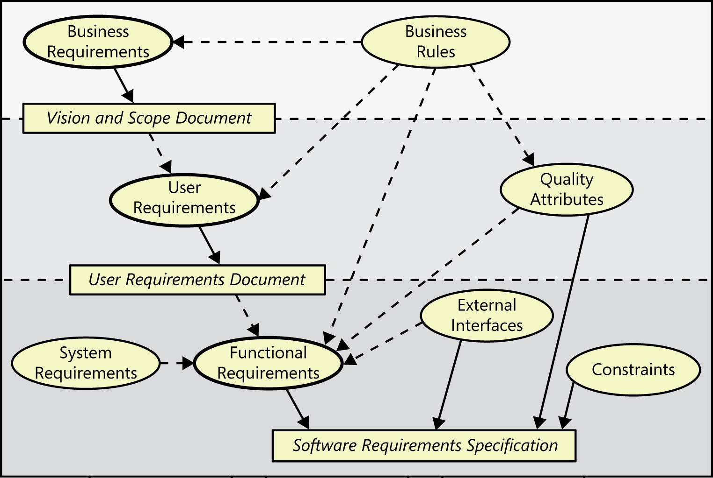
BASIC TERMS

Slide 17
BASIC TERMS
The ovals in represent types of requirements information
The rectangles indicate documents in which to store that information.
The solid arrows indicate that a certain type of information typically is stored in the indicated document.
(Business rules and system requirements are stored separately from software requirements, such as in a business rules catalog or a system requirements specification, respectively.)
The dotted arrows indicate that one type of information is the origin of or influences another type of requirement.
Data requirements are not shown explicitly in this diagram. Functions manipulate data, so data requirements can appear throughout the three levels.

Slide 18
Requirements Three Level
Software requirements include three distinct levels:
Business requirements
User requirements, and
Functional requirements.
In addition, every system has an assortment of nonfunctional requirements.
The model in Figure 1-1 illustrates a way to think about these diverse types of requirements.
This model is not all-inclusive, but it does provide a helpful scheme for organizing the requirements knowledge you’ll encounter.

Slide 19
Business Requirements
A high-level business objective of the organization describe why the organization is implementing the system.
It is The business benefits the organization hopes to achieve.
EXAMPLE
Suppose an airline wants to reduce airport counter staff costs by 25 percent. This goal might lead to the idea of building a kiosk that passengers can use to check in for their flights at the airport.
Business requirements typically come from the funding sponsor for a project, the acquiring customer, the manager of the actual users, the marketing department, or a product visionary.

Slide 20
User Requirement
It describe what goals or tasks the user will be able to perform with the product that will provide value to someone.
The domain of user requirements also includes descriptions of product attributes or characteristics that are important to user satisfaction.
Ways to represent user requirements include use cases, user stories, and event-response tables.
Ideally, actual user representatives/stakeholders will provide this information.
Example: “As a passenger, I want to check in for a flight so I can board my airplane.”

Slide 21
Functional Requirements
A description of a behavior that a system will exhibit under specific conditions.
Functional requirements describe what the developers must implement to enable users to accomplish their tasks (user requirements), thereby satisfying the business requirements.
This alignment among the three levels of requirements is essential for project success.
Functional requirements often are written in the form of the traditional “shall” statements:
EXAMPLE:
“The Passenger shall be able to print boarding passes for all flight segments for which he has checked in” or
“If the Passenger’s profile does not indicate a seating preference, the reservation system shall assign a seat.”

Slide 22
Business Rule
A policy, guideline, standard, or regulation that defines or constrains some aspect of the business.
Not a software requirement in itself, but the origin of several types of software requirements.
However, they often dictate that the system must contain functionality to comply with the pertinent rules.
Sometimes, as with corporate security policies, business rules are the origin of specific quality attributes that are then implemented in functionality.
Therefore, you can trace the genesis of certain functional requirements back to a particular business rule.

Slide 23
Constraint
A restriction that is imposed on the choices available to the developer for the design and construction of a product.
Dev Tool language, Platform Version, Certain Design pattern etc.

Slide 24
External Interface Requirement
A description of a connection between a software system and a user, another software system, or a hardware device.
Some of nonfunctional requirements describe external interfaces between the system and the outside world.

Slide 25
Feature
A feature consists of one or more logically related system capabilities that provide value to a user and are described by a set of User/Functional requirements.
A customer’s list of desired product features is not equivalent to a description of the user’s task-related needs.
Figure illustrates a feature tree, an analysis model that shows how a feature can be hierarchically decomposed into a set of smaller features, which relate to specific user requirements and lead to specifying sets of functional requirements

Slide 26
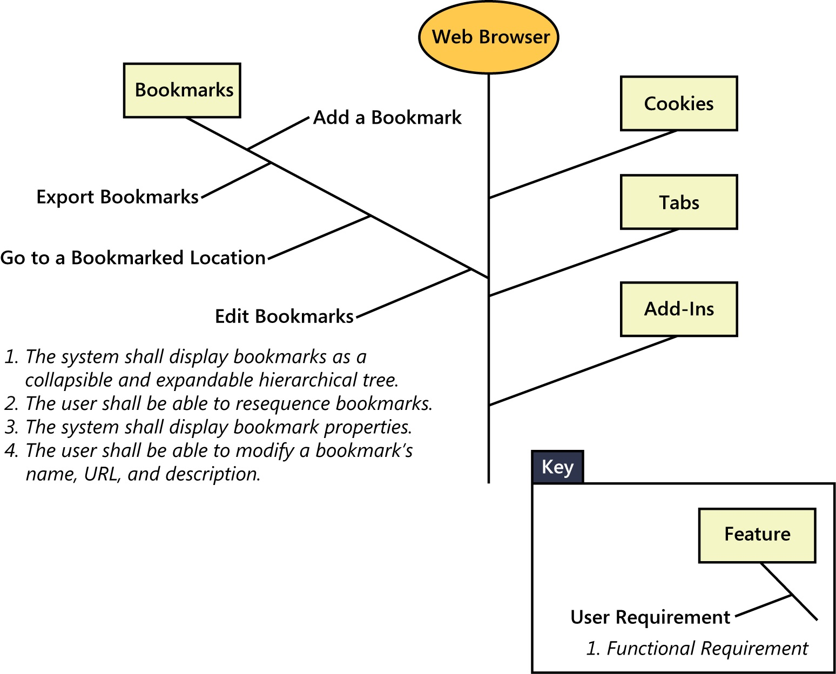
Feature

Slide 27
Non Functional Requirements
A description of a property or characteristic that a system must exhibit or a constraint that it must respect.
In addition to functional requirements, the SRS contains an assortment of nonfunctional requirements.
For many years, the requirements for a software product have been classified broadly as either functional or nonfunctional.
The functional requirements are evident: they describe the observable behavior of the system under various conditions.
However, many people dislike the term “nonfunctional.”
That adjective says what the requirements are not, but it doesn’t say what they are.
We are sympathetic to the problem, but we lack a perfect solution.

Slide 28
Non Functional Requirements
Other-than-functional requirements might specify not what the system does, but rather how well it does those things.
They could describe important characteristics or properties of the system.
These include the system’s availability, usability, security, performance, and many other characteristics
Some people consider nonfunctional requirements to be synonymous with quality attributes, but that is overly restrictive.
For example, design and implementation constraints are also nonfunctional requirements, as are external interface requirements.

Slide 29
Non Functional Requirements
Still other nonfunctional requirements address the environment in which the system operates, such as platform, portability, compatibility, and constraints.
Many products are also affected by compliance, regulatory, and certification requirements.
There could be localization requirements for products that must take into account the cultures, languages, laws, currencies, terminology, spelling, and other characteristics of users.
Though such requirements are specified in nonfunctional terms, the business analyst typically will derive numerous bits of functionality to ensure that the system possesses all the desired behaviors and properties.

Slide 30
Non Functional Requirements
Rather than worry about precisely what you call these sorts of information, just make sure that they are part of your requirements elicitation and analysis activities.
You can deliver a product that has all the desired functionality but that users hate because it doesn’t match their (often unstated) quality expectations.

Slide 31
Quality Attribute
A kind of nonfunctional requirement that describes a service or performance characteristic of a product.
Quality attributes are also known as quality factors, quality of service requirements, constraints etc
They describe the product’s characteristics in various dimensions such as performance, safety, availability, and portability.

Slide 32
System Requirement
A top-level requirement for a product that contains multiple subsystems, which could be all software or software and hardware.
System requirements describe the requirements for a product that is composed of multiple components or subsystems.
A system can be:
All software OR
Both software and hardware subsystems.
A good example of a “system” is the cashier’s workstation in a supermarket.
There’s a bar code scanner integrated with a scale, as well as a hand-held bar code scanner.

Slide 33
System Requirement
The cashier has a keyboard, a display, and a cash drawer.
You’ll see a card reader and PIN pad for your loyalty card and credit or debit card, and perhaps a change dispenser.
You might see up to three printers for your purchase receipt, credit card receipt, and coupons you don’t care about.
These hardware devices are all interacting under software control.

Slide 34
Software Requirement Specification (SRS)
The business analyst (BA) documents functional requirements in a software requirements specification (SRS), which describes as fully as necessary the expected behavior of the software system.
The SRS is used in development, testing, quality assurance, project management, and related project functions.
People call this by many different names, including business requirements document, requirements document, and others.
An SRS could be a report generated from information stored in a requirements management tool.

Slide 35
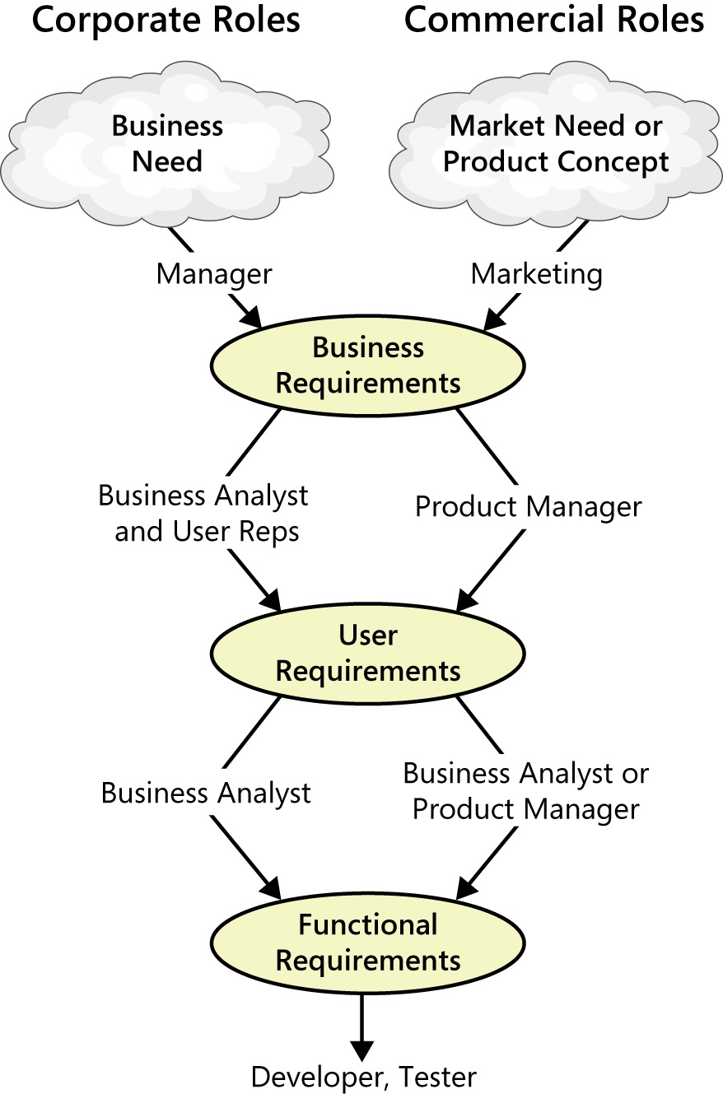
BASIC TERMS

Slide 36
Requirement Three Levels
Working with the three levels
Figure illustrates how various stakeholders might participate in eliciting the three levels of requirements.
Different organizations use a variety of names for the roles involved in these activities depending on whether the developing organization is an internal corporate entity or a company building software for commercial use.
think about who performs these activities in your organization.

Slide 37
Requirement Three Levels
Based on an identified business need, a market need, or an exciting new product concept, managers or marketing define the business requirements.
In the corporate environment, a business analyst then typically works with user representatives to identify user requirements.
Companies developing commercial products often identify a product manager to determine what features to include in the new product.

Slide 38
Requirement Three Levels
Each user requirement and feature must align with accomplishing the business requirements.
From the user requirements, the BA or product manager derives the functionality that will let users achieve their goals.
Developers use the functional and nonfunctional requirements to design solutions that implement the necessary functionality, within the limits that the constraints impose.
Testers determine how to verify whether the requirements were correctly implemented.

Slide 39
Requirement Three Levels
It’s important to recognize the value of recording vital requirements information in a shareable form, rather than treating it as oral tradition

Slide 40
Major Requirement Deliverables
Shown earlier, identified three major requirements deliverables:
Vision and scope document
User requirements document, and
A software requirements specification.
You do not necessarily need to create three discrete requirements deliverables on each project but combine some of this information, particularly on small projects.
However, recognize that these three deliverables contain different information, developed at different points in the project, possibly by different people, with different purposes and target audiences.

Slide 41
Requirement Flow
The model in Figure 1-1 showed a simple top-down flow of requirements information.
In reality, you should expect cycles and iteration among the business, user, and functional requirements.
Whenever someone proposes a new feature, user requirement, or bit of functionality, the analyst must ask, “Is this in scope?”
If the answer is “yes,” the requirement belongs in the specification.
If the answer is “no,” it does not, at least not for the forthcoming release or iteration.

Slide 42
Requirement Flow
The third possible answer is “no, but it supports the business objectives, so it ought to be.
In that case, whoever controls the project scope—the project sponsor, project manager, or product owner—must decide whether to increase the current project’s or iteration’s scope to accommodate the new requirement.
This is a business decision that has implications for the project’s schedule and budget and might demand trade-offs with other capabilities.
An effective change process that includes impact analysis ensures that the right people make informed business decisions about which changes to accept and that the associated costs in time, resources, or feature trade-offs are addressed.

Slide 43
Product vs Project Requirement
Properties of a software system to be built are called Product requirements.
An SRS houses the product requirements
It should not include design or implementation details (other than known constraints), project plans, test plans, or similar information.
Such items are part of Project requirements.

Slide 44
Product vs Project Requirement
Project requirements include:
Physical resources the development team needs
(such as workstations, special hardware devices, testing labs, testing tools and equipment, team rooms, and videoconferencing equipment.)
Staff training needs.
User documentation
(including training materials, tutorials, reference manuals, and release notes.)

Slide 45
Product vs Project Requirement
Project requirements include:
Support documentation
(such as help desk resources and field maintenance and service information for hardware devices.)
Infrastructure changes
(needed in the operating environment.)

Slide 46
Product vs Project Requirement
Project requirements include:
Requirements and procedures for releasing the product, (installing it in the operating environment, configuring it, and testing the installation.)
Requirements and procedures for transitioning from an old system to a new one
(Such as data migration and conversion requirements, security setup, production cutover, and training to close skills gaps; these are sometimes called transition requirements.)

Slide 47
Product vs Project Requirement
Project requirements include:
Product certification and compliance requirements.
Revised policies, processes, organizational structures, and similar documents.
Sourcing, acquisition, and licensing of third-party software and hardware components.
Beta testing, manufacturing, packaging, marketing, and distribution requirements.
Requirements for obtaining legal protection
(patents, trademarks, or copyrights for intellectual property related to the software.)

Slide 48
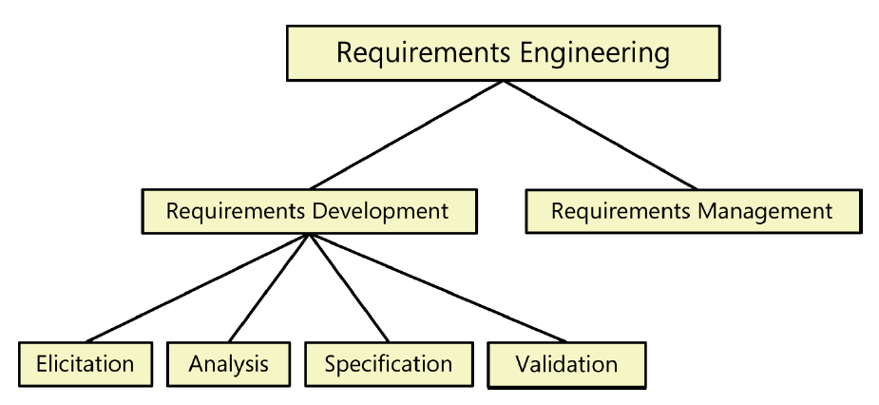
Requirement Engineering

Slide 49
Requirements Development
These subdisciplines encompass all the activities involved with exploring, evaluating, documenting, and confirming the requirements for a product.
Following are the essential actions in each subdiscipline.
Elicitation: encompasses all of the activities involved with discovering requirements, such as interviews, workshops, document analysis, prototyping, and others.
Analyzing: requirements involves reaching a richer and more precise understanding of each requirement and representing sets of requirements in multiple ways.

Slide 50
Requirements Development
Requirements Specification: involves representing and storing the collected requirements knowledge in a persistent and well-organized fashion.
Requirements Validation: confirms that you have the correct set of requirements information that will enable developers to build a solution that satisfies the business objectives.
Iteration is a key to requirements development success.
Plan for progressively refining high-level requirements into more precision and detail
Confirm correctness with users.
This takes time and it can be frustrating.

Slide 51
Requirements Management
Requirements management activities include the following:
Defining the requirements baseline
(A snapshot in time that represents an agreed-upon, reviewed, and approved set of functional and nonfunctional requirements, often for a specific product release or development iteration)
Evaluating the impact of proposed requirements changes
Incorporating approved changes into the project
(in a controlled way)

Slide 52
Requirements Management
Keeping project plans current with the requirements
(as they evolve)
Negotiating new commitments
(based on the estimated impact of requirements changes)

Slide 53
Requirements Management
What, why, and who:
Defining the relationships and dependencies
(that exist between requirements)
Tracing individual requirements
(to their corresponding designs, source code, and tests)
Tracking requirements status and change activity
(throughout the project)

Slide 54
Requirements Management
Purpose of Requirement Management is to:
Anticipate and
Accommodate
the very real changes that you can always expect
(so as to minimize their disruptive impact on the project.)
Following Figure provides another view of the boundary between requirements development and requirements management.

Slide 55
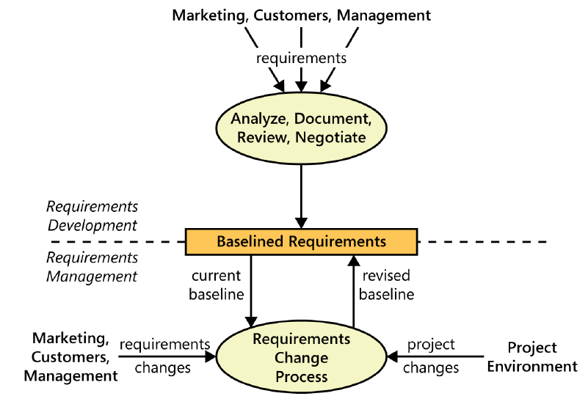
Requirements development

